Slide 1
NSQ1, Session 11
GraphQL in neo4j

Slide 2
Neo4jGraphQL
Neo4jGraphQL is a plugin for Apollo Server
It allows you to use GraphQL to query and modify your database
It defines standard Query and Mutation objects
You can add to those with your own Query and Mutation objects
It defines a number of directives to help set up the resolvers

Slide 3
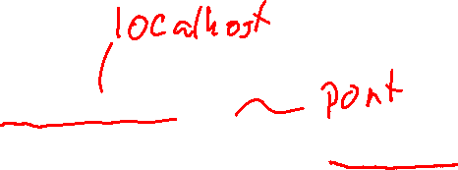
Connecting to neo4j
const driver = neo4j.driver(
"bolt://127.0.0.1:7687",
neo4j.auth.basic("neo4j", "password"),
{encrypted: "ENCRYPTION_OFF"}
)
await driver.verifyConnectivity()

Slide 4
Starting Apollo
const content = await fs.readFile('./friends.sdl', 'utf8')
const typeDefs = `#graphql
${content}`
const graphQL = new Neo4jGraphQL({typeDefs, driver})
const schema = await graphQL.getSchema()
const server = new ApolloServer({schema})
const {url} = await startStandaloneServer(server, {
listen: { port: 4000}
})

Slide 5
Types and Labels
Declare a GraphQL type with the same name as a neo4j Label type Person { id: Int!, name: String! }
The plugin creates resolvers that use the label
It handles all attributes
But it doesn't handle relationships

Slide 6
The @relationship directive
The @relationship directive defines attributes using relationships: spouse: Person @relationship(type: "SPOUSE", direction: OUT) children: [Person!]! @relationship(type: "CHILD", direction: OUT) parents: [Person!]! @relationship(type: "CHILD", direction: IN)

Slide 7
The @cypher directive
Use the @cypher directive to define your own queries and mutations:
Query: siblings(id: Int!): [Person!]! @cypher(statement: "MATCH … RETURN p", columnName: "p")
Mutation: See uploaded .sdl file.

